Slide 1
LiDAR and I3D CNN
Implementing advanced detection techniques in industrial robots.

Slide 2
Introduction
This project aims to enhance industrial robot safety and efficiency by integrating a single LiDAR sensor and an Inflated 3D Convolutional Neural Network (I3D CNN) algorithm to detect humans and objects in real-time. By creating two concentric detection zones using LiDAR data, the robot's behavior can dynamically adjust: reducing speed when objects are nearby and stopping entirely if objects enter a critical proximity. This approach replaces traditional cage-based systems, increasing safety, flexibility, and workspace efficiency.

Slide 3
01
LiDAR Technology

Slide 4

Principles of LiDAR
LiDAR, or Light Detection and Ranging, employs laser pulses to measure distances and create precise, high-resolution 3D maps of environments. This technology operates by emitting laser beams towards the ground or objects, which then reflect back to the sensor, allowing for the calculation of distances based on the time it takes for the light to return. LiDAR systems can utilize various methods such as airborne, terrestrial, or mobile configurations, facilitating applications across multiple terrains and environments.

Slide 5
Applications in Robotics
LiDAR is increasingly utilized in robotics for effective navigation, mapping, and object detection. Industrial robots use LiDAR for automated warehouse operations, enabling them to recognize shelf layouts and navigate safely around obstacles. Furthermore, in applications such as autonomous vehicles, LiDAR aids in real-time perception of surroundings, allowing for smooth and safe operation. This technology is integral in enhancing the operational efficiency and safety of robotic systems.

Slide 6
Advantages and Limitations
LiDAR technology offers significant advantages including high accuracy, detailed spatial resolution, and the ability to function in various environmental conditions, such as low light. However, limitations include high costs, sensitivity to weather conditions like heavy rain or fog, and challenges in complex urban environments where multiple reflections can cause inaccuracies. Additionally, the integration of LiDAR with existing systems can be technically demanding.

Slide 7
02
I3D CNN Overview

Slide 8
Architecture of I3D CNN
The Inflated 3D Convolutional Neural Network (I3D CNN) extends traditional 2D ConvNets by incorporating a 3D approach. This architecture is designed to process videos by considering both spatial and temporal dimensions. It utilizes inflated convolutions, where 2D filters are expanded into 3D, allowing the network to capture motion over time, which is particularly effective for action recognition tasks in robotic applications.

Slide 9

Training and Dataset Requirements
Training an I3D CNN requires extensive computational resources and large datasets to ensure effective learning. Datasets must include diverse action categories to prevent overfitting and improve generalization to real-world scenarios. Commonly used datasets in the domain of object detection include Kinetics and UCF101, which provide a wide array of video samples for robust model training.

Slide 10
Performance Metrics in Detection
Evaluating the performance of I3D CNN for object detection involves various metrics such as accuracy, precision, recall, and F1 score. These metrics help in assessing how well the model identifies targets in real-time environments. Additionally, inference speed is critical for real-time applications, necessitating optimizations in the model architecture to meet the performance standards required by industrial robots.

Slide 11
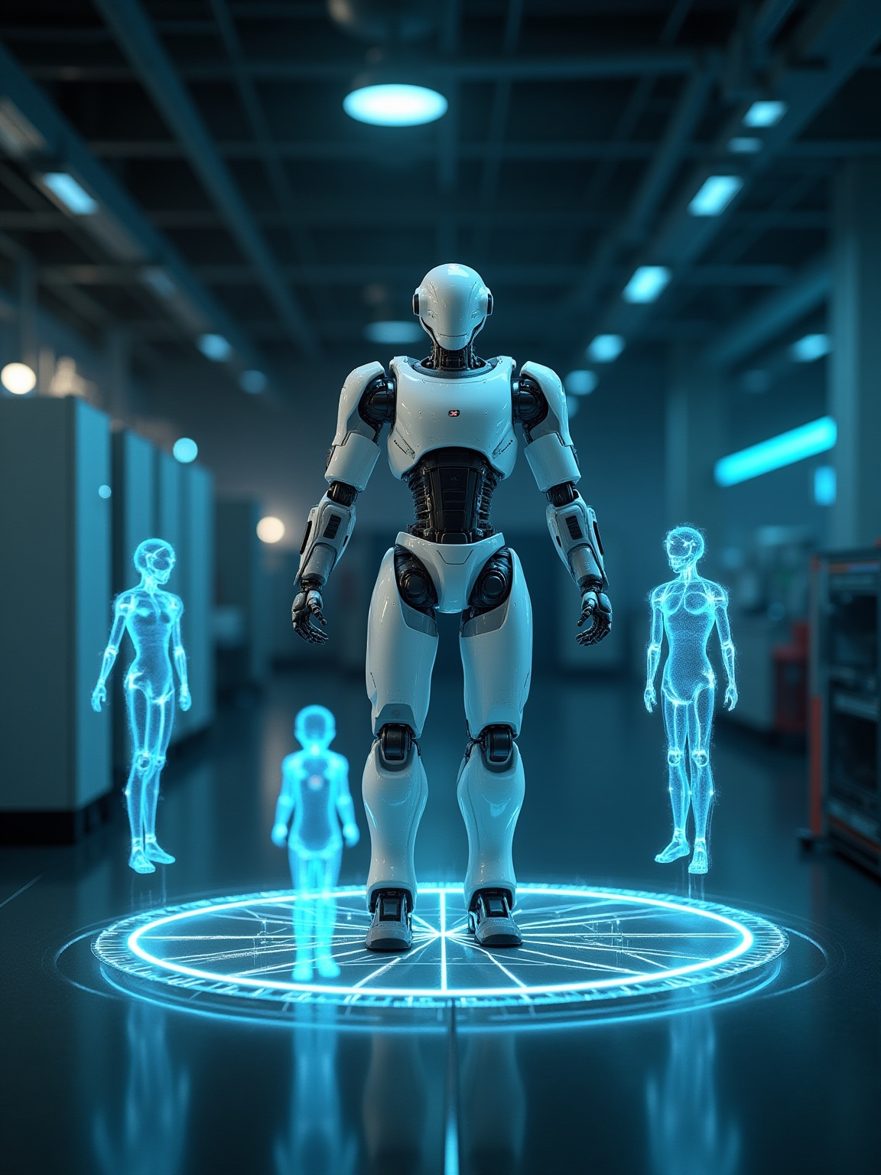
Conclusions
The integration of LiDAR technology and I3D CNN algorithms enhances the capabilities of industrial robots in detecting humans and objects in real-time. While LiDAR provides accurate environmental mapping, I3D CNN's advanced processing enables effective action recognition, proving crucial for safety and efficiency in robotic operations.

Slide 12
Thank you!
Do you have any questions?
+00 000 000 000

